Slide 1

MediaVault – Media Rights, Licensing & Royalty Management
CB23F35 · LOW-CODE APPLICATION DEVELOPMENT USING ZOHO CREATOR
A rights, licensing and royalty tracking application built on Zoho Creator
Pragadeesh
Reg. No. 240701388 · B.E. Computer Science Engineering
Course Faculty: Bhuvaneshwaran B · HOD: Dr. J. Manoranjani
Notes:
Introduce MediaVault: a Zoho Creator application that checks media distribution requests against licenses, records violations and tracks royalties. Presented for the End Semester Examination, November 2026.

Slide 2





Rights and royalties are hard to track by hand
THE PROBLEM
A media company must know who owns each title, which licenses cover which territories and dates, and how much each rights holder is owed. When this lives in separate sheets, a request outside a license can slip through and royalties can be miscalculated.
Track ownership
Manage licenses
Check requests
Calculate royalties
Explain and connect
Who owns each title and in what share
Licensee, territory, period, fee and status
Does a license cover the territory and dates?
Revenue times percentage, with no duplicate payments
An AI notice for each violation, plus an API and CRM link
Notes:
Five needs drive the design. The point to make: when ownership, licenses and revenue live in separate sheets, a request outside a license can slip through and royalties can be wrong.

Slide 3
One application from license to royalty
THE SOLUTION
What it does
9
22
Stores content, ownership shares and rights holders
Records licenses by territory, period, fee and status
Checks every distribution request against licenses
Grades each result from Approved to Critical
Calculates and validates royalty payments
Shares license coverage through a Custom API
data forms
reports
1
16
dashboard page
form workflows
2
1
Roles: CEO at the top, with Content Owner, Distributor and Finance Manager beneath it. Each of these three has its own permission profile.
Deluge functions
Custom API
Notes:
Counts come from the exported app file: 9 forms, 22 reports (9 standard and 13 custom), 1 dashboard page, 16 form workflows, 2 Deluge functions and 1 Custom API.

Slide 4
Every request is checked against the licenses
HOW IT WORKS
1
Submit request
2
Find licenses
3
Test status and dates
4
Record the result
›
›
›
Content, platform, territory, dates, expected revenue
Match the content and the requested territory
Status must be active and the period must cover the request
Approve it, or open a violation record
Result | Meaning
Approved | An active license covers the territory and the period
Medium | Covered, but the license ends within 30 days
Low | Covered, but expected revenue is missing or zero
High | A license exists but cannot support the request
Critical | No license exists for that territory
One check, five outcomes
High and Critical mark the request a Rights Violation
One violation record is created per request, named VIO plus the request ID
Medium and Low are warnings on approved requests
Notes:
Walk through the four steps, then the five outcomes. A violation record is created once per request for High and Critical results. Medium and Low are warnings on requests that are still approved. The 30-day warning window is set in the workflow.

Slide 5
Four layers on one low-code platform
SYSTEM DESIGN
Users: CEO · Content Owner · Distributor · Finance Manager
Presentation
Menu, nine forms, reports and the MediaVault Dashboard
Zoho Creator · MediaVault
Logic
Forms
9 forms
Workflows
Deluge scripts
Views
Reports, dashboard
Deluge form workflows and two functions
Data
Nine linked forms with lookups
Zoho CRM
Deal created
Custom API
License coverage
Zia AI agent
Explains violations
Integrations
Custom API, Zia AI agent and a Zoho CRM connection
Notes:
Everything runs inside Zoho Creator and is used from a web browser. Zoho CRM, the Custom API and the AI agent are the connections to the outside.

Slide 6
Nine forms hold the data
DATA MODEL
Content and ownership
Licensing
Money
Content
ID, type, language, release year, rights and ownership status
Licenses
Licensee, territory, period, fee, royalty and status
Revenue
Revenue ID, date, amount and source
Content Ownership
Ownership claims, shares and verification
Distribution Requests
Platform, territory, period and expected revenue
Royalty Rules
A holder's percentage, with effective dates
Rights Holders
The people and companies that own or earn from a title
Rights Violations
Reason, severity, status and AI explanation
Royalty Payments
One payment per revenue record and rights holder
Forms are linked by lookups: requests point to content, violations to requests, and payments to revenue and rights holders.
Notes:
Three groups of forms. Point out the lookups: requests point to content, violations point to requests, and payments point to a revenue record and a rights holder.

Slide 7
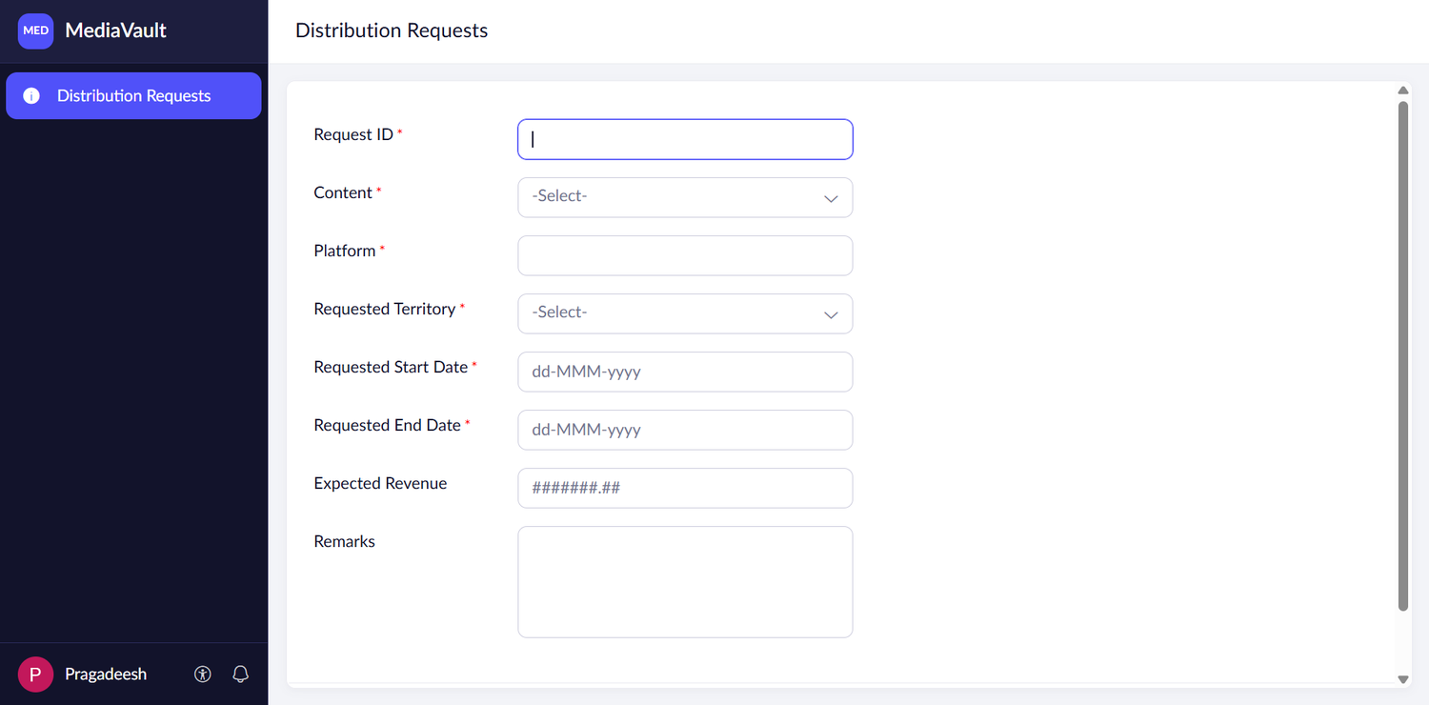
Forms in live mode
IMPLEMENTATION
Distribution Requests
Red asterisks mark required fields
Content and Requested Territory are dropdowns
Dates use the dd-MMM-yyyy format
Expected Revenue is optional, but a missing value raises a Low warning
Request Status is set by the workflow, not typed
The other eight forms follow the same pattern: required fields, dropdowns for fixed choices, and workflows that fill the system fields.
Notes:
Show the Distribution Requests form. Required fields, dropdowns and the system-set status are the points to make. Offer to open any other form during the demo.

Slide 8
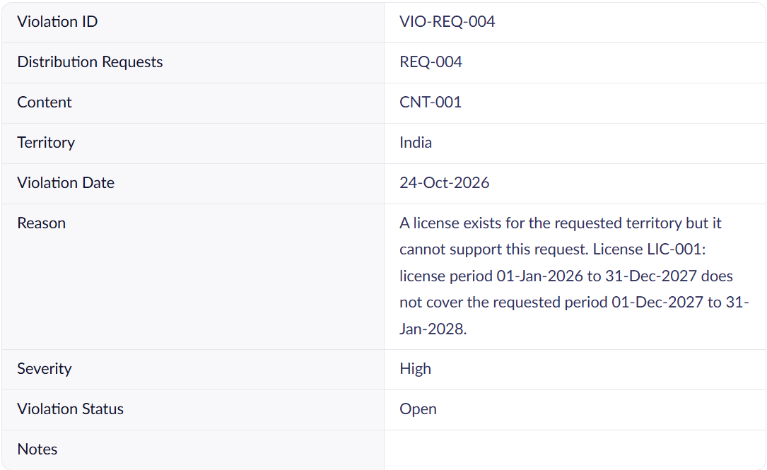
Thirteen custom reports, nine standard
IMPLEMENTATION
Licenses
Active Licenses · Licenses Expiring Soon
2
Requests
Distribution Requests Report · My Requests
2
Violations
Rights Violations Report · Open Violations · Rights Risk Analytics
3
Money
Revenue Report · Royalty Payments Report
2
Violation record VIO-REQ-004: reason, severity and status
Content and ownership
Content ownership · My content · My Ownership Claims · My Rights Holders
Open Violations lists only open cases and also shows the AI Explanation. The nine standard All… reports list every record of each form.
4
Notes:
22 reports in total: one standard All report for each of the 9 forms and 13 custom reports. The violation record on the left shows the reason, severity and status that the rights check stores.

Slide 9
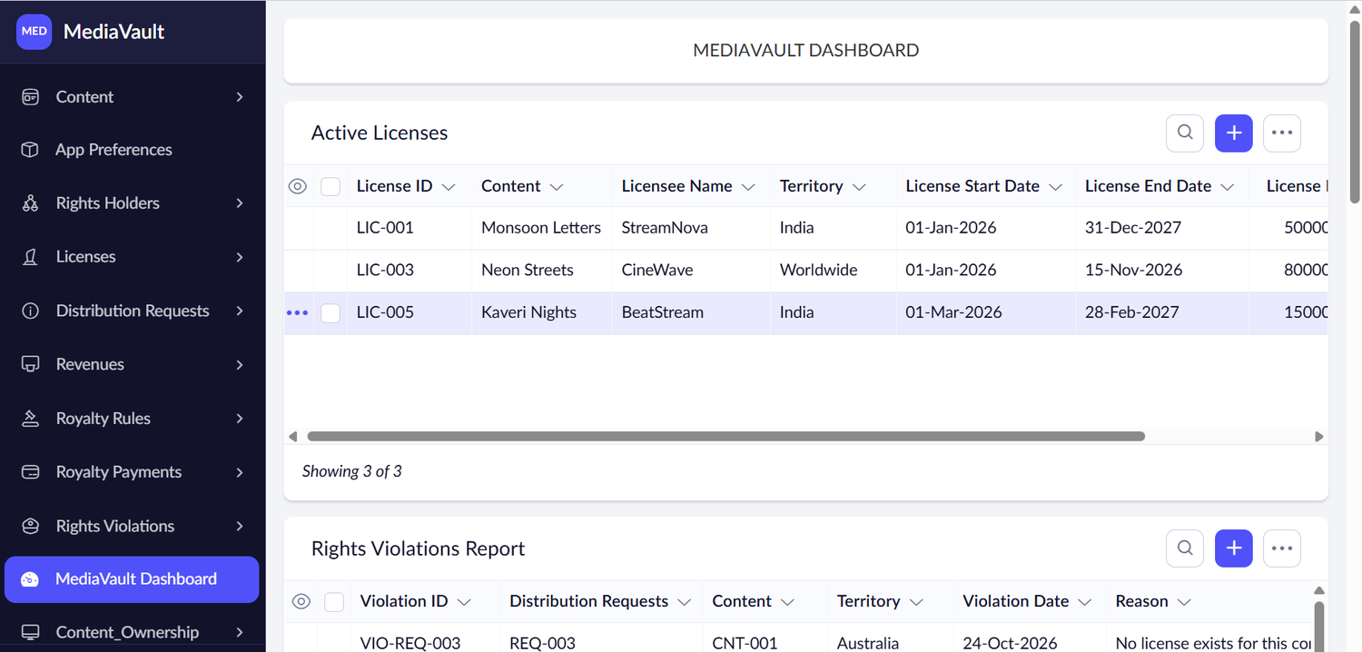
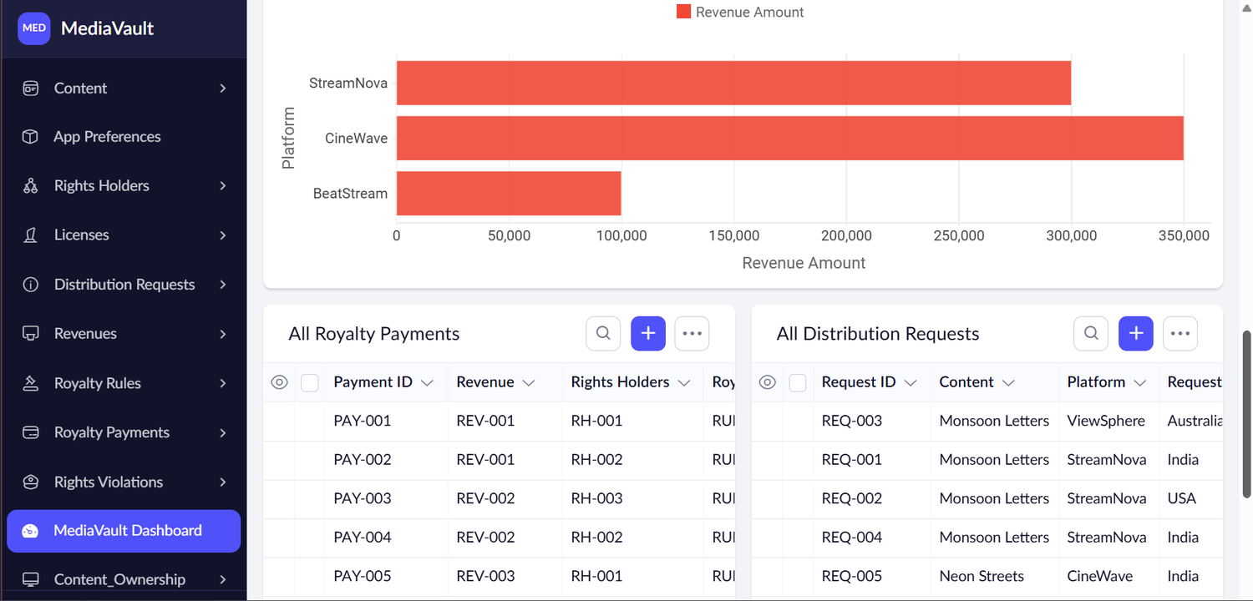
One dashboard for licenses, violations and revenue
IMPLEMENTATION
Active Licenses and Rights Violations Report
Revenue by platform, with payments and requests
3 active licenses
LIC-001, LIC-003 and LIC-005 are listed on the dashboard
Revenue by platform
CineWave is highest, then StreamNova, then BeatStream
Embedded reports
Active Licenses, Rights Violations, Royalty Payments and Distribution Requests
Notes:
The dashboard embeds reports and a revenue chart. Say which values the screenshots show: three active licenses, and CineWave highest for revenue.

Slide 10
Short Deluge workflows carry the rules
AUTOMATION
1
2
3
4
Check distribution rights
Explain violation
Ownership rules
Royalty calculation
Distribution Requests · on add
Rights Violations · on add
Content Ownership and Licenses · add or edit
Royalty Payments · add or edit
Matches the request to licenses and sets status and severity
Zia writes a short notice from the stored facts
Verified shares stay within 100%; a license goes Active only after verification
Amount is revenue times percentage; duplicate payments are blocked
Excerpt: Check Distribution Rights
16 form workflows in total. The others hide system fields, protect Status and Severity from edits and validate dates.
if (solidCover || nearCover) { newStatus = "Approved"; }
else if (matchCount == 0) { severity = "Critical"; }
else { severity = "High"; }
Notes:
Four workflows do the main work. The code box is a short excerpt from Check Distribution Rights. 16 form workflows in total; the rest hide system fields, protect Status and Severity from edits and validate dates.

Slide 11
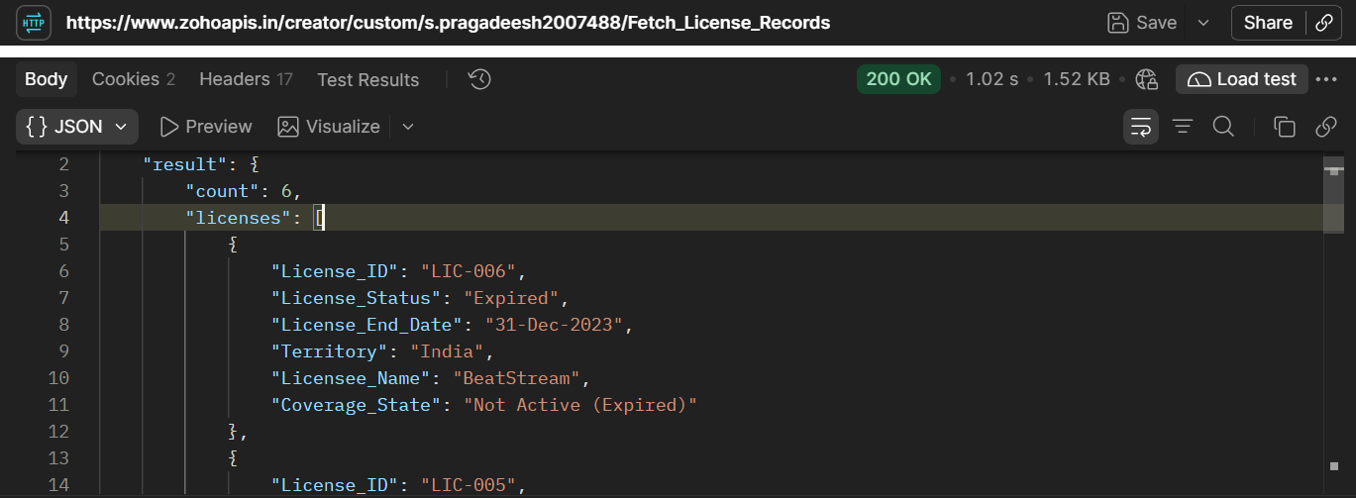

Custom API, AI agent and Zoho CRM
INTEGRATIONS
Zia AI agent
The violation_explainer agent uses the Explain Violation tool. Its endpoint takes POST with OAuth2.
Created · OAuth2
Fetch License Records: GET returns 200 OK with 6 licenses
Zoho CRM
Each license in the response carries a Coverage State. LIC-006 (BeatStream, India, ended 31-Dec-2023) shows Not Active (Expired).
Saving a license created a deal in Zoho CRM through the zoho_crm_connection link.
Tested · deal created
Notes:
The Postman response proves the Custom API works. The AI agent and the CRM link are proof-of-concept integrations. The API key shown in Postman has been cropped out of the screenshot.

Slide 12
Rights checks end in clear outcomes
RESULTS
HIGH
What the values show
REQ-004 · Monsoon Letters · StreamNova · India
6 licenses returned by the Custom API, including expired LIC-006
3 licenses are active on the dashboard
Violation IDs follow the pattern VIO plus the request ID
Payments PAY-001 to PAY-005 each link a revenue record to a rights holder
REV-001 is shared by RH-001 and RH-002
Requested 01-Dec-2027 to 31-Jan-2028, but license LIC-001 runs 01-Jan-2026 to 31-Dec-2027. Violation VIO-REQ-004 was opened with status Open.
CRITICAL
REQ-003 · Monsoon Letters · ViewSphere · Australia
No license exists for Australia. Violation VIO-REQ-003 was created for this request on 24-Oct-2026.
Notes:
Two real cases from the app. REQ-004 asks for dates beyond the license end, so it is High. REQ-003 asks for Australia, where no license exists, which is the Critical case.

Slide 13
Objectives against the evidence
OBJECTIVES VS EVIDENCE
Objective | Implemented through | Status
Store content, ownership and licenses | Nine forms with lookups | Achieved
Check requests against licenses | Check Distribution Rights workflow | Achieved
Grade rights problems by severity | Five levels, Approved to Critical | High and Critical seen
Reports and a dashboard | 22 reports and the MediaVault Dashboard | Achieved
Royalty payments | Royalty Rules, Payments and a calculation workflow | Records seen
License coverage API | Fetch License Records (Custom API) | Achieved
AI explanation of violations | Zia in explainViolation, plus an AI agent | Reported
CRM link | Connection and a deal-creation test | Achieved
Reported: built in the app but not yet shown in a screenshot.
Notes:
Be clear about what the screenshots show and what is only reported. AI explanation is built into the app but has not been captured in a screenshot yet.

Slide 14
Tests observed, open items logged
TESTING AND DEBUGGING
4
checks observed
D-01
Content Type has the choice “Documentery”
Fix: Rename it to Documentary and update the records
High and no-license violations, API 200 OK, CRM deal
D-02
Rights Risk Analytics repeats the Violations Report
Fix: Group it by severity and status
2
not yet captured
D-03
Expiry alert changed input after saving, so status was not kept
Fix: Update the saved record (fix prepared)
AI explanation and royalty calculation
D-04
Platform is free text on Distribution Requests
Fix: Use a dropdown or a lookup of platforms
5
open items
D-05
The trial period is ending
Fix: Upgrade, or move the app with its .ds and CSV exports
Logged on the right, each with a fix
Notes:
Four checks were seen working in screenshots or in the app. Two features are built but not yet captured. Five open items are listed with their fixes. The expiry-alert fix is prepared in the enhanced app file.

Slide 15
Roadmap: clean up, automate, extend
FUTURE ENHANCEMENTS
1
Short term
2
Medium term
3
Long term
Dropdown or lookup for Platform
Fix the expiry alert
Summary report by severity and status
Scheduled expiry reminders by e-mail
CRM deals without duplicates
E-mail alert to the rights team on Critical
Distributor self-service portal
Royalty statements as PDF
Import of platform revenue data
Cleaner data and fewer wrong entries
Less manual follow-up
More users and richer data
Notes:
A simple three-stage roadmap. Short term clears the open items. Medium term adds automation. Long term widens who can use the app.

Slide 16

MediaVault checks every distribution request against its licenses and records the outcome.
Thank you
Each request is graded Approved, Medium, Low, High or Critical, and a violation record is opened when it fails.
Pragadeesh
Reports, a dashboard, a Custom API, an AI agent and a CRM link show and share the position.
240701388 · Department of CSE
Rajalakshmi Engineering College
Still open: screenshots of the AI explanation and royalty calculation, and a Platform dropdown.
Notes:
One-sentence summary: MediaVault is a Zoho Creator application that checks distribution requests against licenses, records violations and tracks royalties, with an AI explanation, a Custom API and a CRM link.

